Slide 1
<Nicole Zoe Offei-Koranteng>
Web Tech Fall 2021 Final Exams

Slide 2
Nicole Zoe Offei-Koranteng is developing a data powered website to help PanFoods Restuarant solve the problem of overcrowding in their restaurant and also giving customers the convenience of making their orders ahead of time.

Slide 3
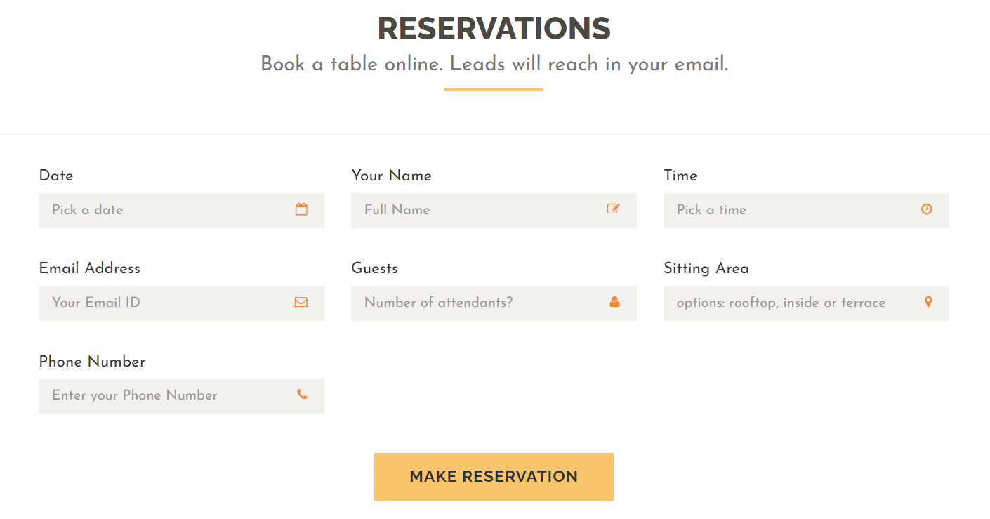

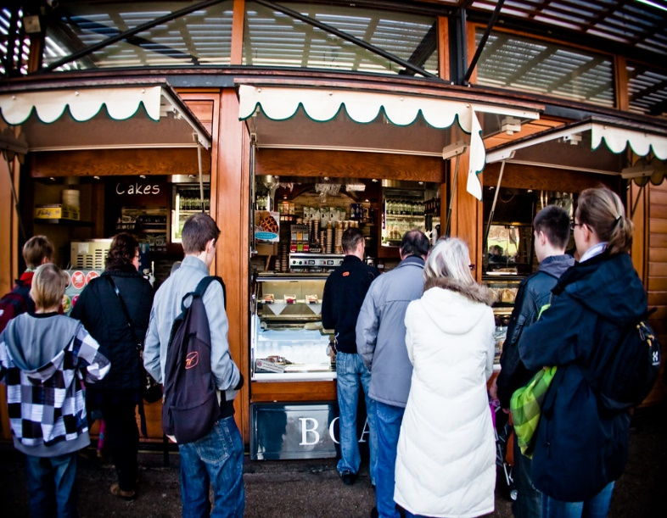

PanFoods Reservations
did
FINISH: Why are the users better off with the website than before.
Without the website, it was a challenge for some for customer to know if the would be space available for an event like a board meeting on a short notice. Hence, it is more convenient for the individual to know what is available on the menu before hand and also the space available.
PERSONA(s) who are the people involved in using the website and what are their background.
PanFoods Reservation is a restaurant business located in Accra. With this platform it brings more awareness to the business. as now it is easier to track keep track of reservations.
PROBLEM:
Due to the rise in the number of tourists visiting Accra, Ghana, the queues at public places especially restaurants is never ending. As a result of this, PanFoods solves the problem of overcrowding and time wastage by giving customers the option of making bookings at any of our branches ahead of time.
PAYOFF: What is a simple drawn screen that is illustrative of something the website shows that helps solve the problem. It is likely a report or some results of data entered by the participants. This is the most important square
The website requires the vital information of any user before the next action can be taken. This is for security purposes and to track daily events.

Slide 4
User / Customer
Describe the business, organization, or group of people that will use this website. If a business, describe its products or services and what its purpose is.
PanFoods Reservations is a restaurant that serves everyone. Its main goal is to avoid the inconvenience that comes with eating outside home. It reduces stress through the online reservation system, creates comfort as users can determine their sitting area and also avoid the issue of time wastage: that is, once the customer checks in at the front desk he or she is ushered quickly to the table after the necessary details are taken and confirmed in the system database.
What are the roles of the users who will use the website. One sentence about what they do. For example, in the Attendance system the roles are “students”, “faculty” and “faculty interns”.
The primary users would be the staff of PanFoods Reservations. They manage the system by controlling, organizing and confirming the number of reservation periodically.
The secondary users will be the potential clients. Their role would be to provide their necessary details to make a reservation such as names, phone numbers, sitting area, etc.

Slide 5
Main Functions of the Website
3- 4 functions that will be built to solve the problem.
Displays the available tables in the restaurant so that customers can choose where they want to be seated.
Displays customer’s reservation details.
Displays the foods available during the day.
Stores customers entry in the system’s database.

Slide 6
Architecture
PRESENTATION
(html, JavaScript, style.css)
APPLICATION
(PHP functions)
DATABASE
(PanFoods* database – MySQL workbench)

Slide 7
LINK TO
GIT HUB== https://github.com/Nicole05-git/Final-Project
Sharepoint== https://aucampus-my.sharepoint.com/:f:/g/personal/nicole_koranteng_ashesi_edu_gh/Evn5DC9are5Fgntw9NQDwG4BSLIHB5zfPTBUqxbP1VIOpw?e=w8sGD6

